Slide 1
Java Generics
Maciej Kucharek, Paweł Łagan, Michał Dubel

Slide 2
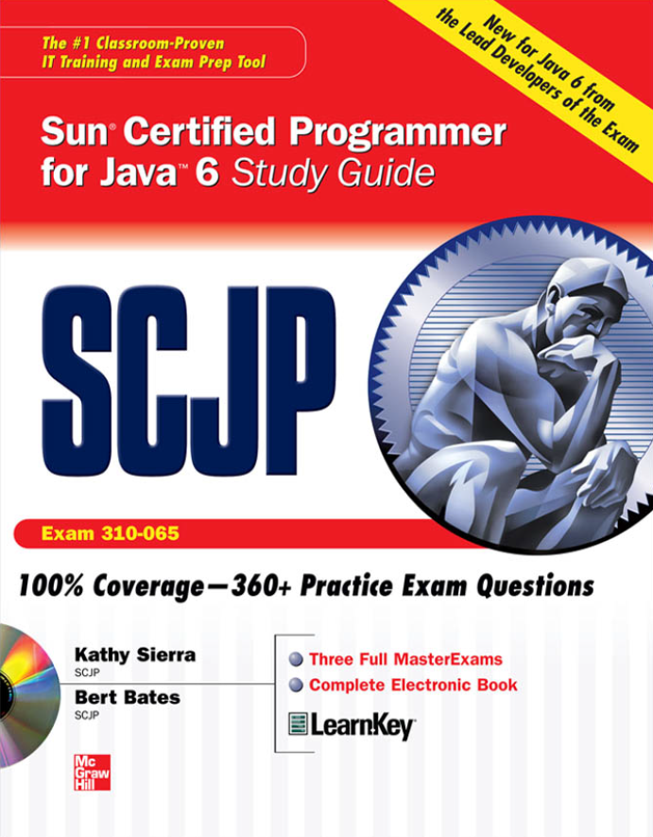
Few words before we start
This workshop session is heavily based on Java Generics and Collections by Maurice Naftalin & Philip Wadler
The workshop just scratches the surface
Java Generics is a pretty advanced topic, and 1hr is not enough to cover it in details
We strongly recommend you to read the book
It gives a solid understanding on how generics work
It also describes the Collection framework, which will be covered later during Java Campaign ☺
Please hold your questions till the end of the presentation

Slide 3
Agenda
Introduction to Java Generics
Generics – definition and syntax
Boxing and unboxing
What you should know about types?
Reifiable and non-reifiable types
Type erasure
Wildcards
Get and Put Principle
Covariant vs Invariant subtyping
Wildcard restrictions
Bounds
Generic classes in the nutshell
What can and what cannot be done with generics?

Slide 4
Introduction to Generics in Java

Slide 5
Introduction to Generics in Java
Generics
An interface or class may be declared to take one or more type parameters, which are written in angle brackets and should be supplied when you declare a variable belonging to the interface or class or when you create a new instance of a class.
interface List<E>
class ArrayList<E>
List<String> list = new ArrayList<>();
where E is a type parameter
Diamond operator – type inference

Slide 6
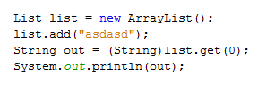
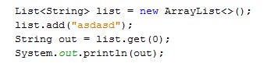
Introduction to Generics in Java
Legacy code
Generic version
Cast is required, without you’ll get compile-time error.
Cast is not required

Slide 7
Introduction to Generics in Java
Type parameter vs Type argument – what is the difference?
Interface List<E> {
}
List<String> list = new ArrayList<>();
E is a type parameter
String is a type argument

Slide 8
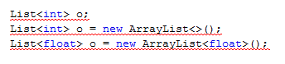
Introduction to Generics in Java
Generics can’t be used with primitive types
Compile-time error

Slide 9
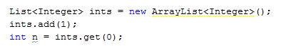
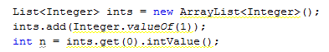
Introduction to Generics in Java
Boxing and unboxing
done automatically where appropriate
Example
is equivalent to sequence:

Slide 10
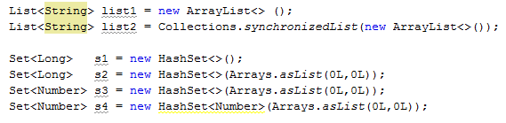
Introduction to Generics in Java
Type argument inference for instance creation expressions
The automatic deduction of the type arguments in a new-expression
Compile-time error in Java 7, but are fine in Java 8

Slide 11
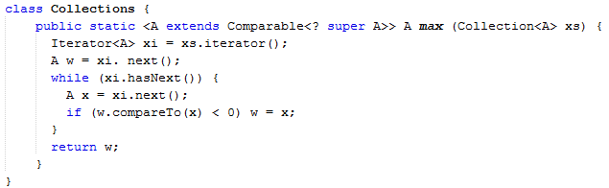
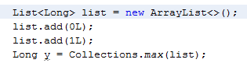
Introduction to Generics in Java
Type argument inference for instance creation expressions
The automatic deduction of the type arguments of a generic method at compile time.
Compiler detects type of A
Explicit type argument specification

Slide 12
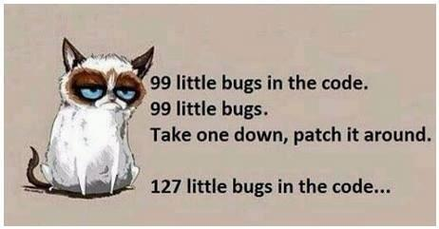
Introduction to Generics in Java
Advantages of Generics:
Stronger type checks at compile time.
Elimination of casts
No runtime overhead.
Enabling programmers to implement generic algorithms – write it once and have more free time
Reusable code means less bugs ☺

Slide 13
Introduction to Generics in Java
Type Parameter Naming Conventions (Oracle)
E - Element (used extensively by the Java Collections Framework)
K - Key
N - Number
T - Type
V - Value
S,U,V etc. - 2nd, 3rd, 4th types
Google Type Parameter Naming Convention:
A single capital letter, optionally followed by a single numeral (such as E, T, X, T2)
A name in the form used for classes, followed by the capital letter T (examples: RequestT, FooBarT).

Slide 14

What you should know about types?

Slide 15
Reifiable types
A reifiable type is a type whose type information is fully available at runtime. This includes primitives, non-generic types, raw types, and invocations of unbound wildcards.
A type is reifiable if it is one of the following:
A primitive type (such as int)
A nonparameterized class or interface type (such as Number, String, or Runnable)
A parameterized type in which all type arguments are unbounded wildcards (such as List<?>, ArrayList<?>, or Map<?, ?>)
A raw type (such as List, ArrayList, or Map)
An array whose component type is reifiable (such as int[], Number[], List<?>[], List[], or int[][])

Slide 16
Non-reifiable types
Non-reifiable types are types where information has been removed at compile-time by type erasure — invocations of generic types that are not defined as unbounded wildcards.
A type is not reifiable if it is one of the following:
A type variable(such as T)
A parameterized type with actual parameters (such as List<Number>, ArrayList<String>, or Map<String, Integer>)
A parameterized type with a bound (such as List<? extends Number> or Comparable<? super String>)

Slide 17
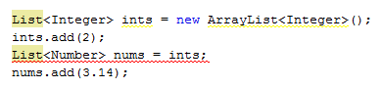
Subtyping and the Substitution Principle
Integer is a subtype of Number
Double is a subtype of Number
ArrayList<E> is a subtype of List<E>
List<E> is a subtype of Collection<E>
Collection<E> is a subtype of Iterable<E>
Subtyping is transitive, meaning that if one type is a subtype of a second, and the second is a subtype of a third, then the first is a subtype of the third
ArrayList<E> is a subtype of Iterable<E>
Substitution Principle: a variable of a given type may be assigned a value of any subtype of that type, and a method with a parameter of a given type may be invoked with an argument of any subtype of that type.
Compile-time error

Slide 18
Type erasure
The erasure of a type is defined as follows:
drop all type parameters from parameterized types
replace any type variable with:
the erasure of its bound
Object – if variable has no bounds
with the erasure of the leftmost bound if it has multiple bounds

Slide 19
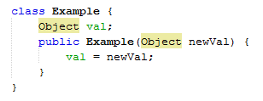
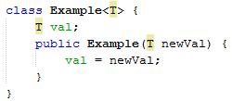
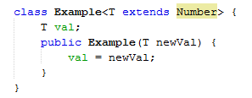
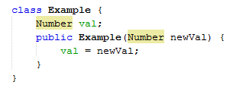
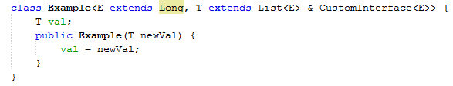
Type erasure
?

Slide 20
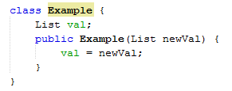
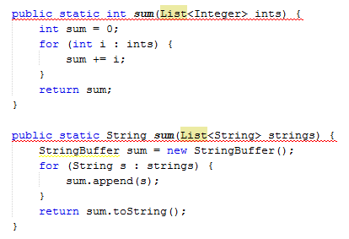
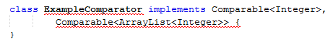
Type erasure
Type erasure implications
Compile-time error

Slide 21
Subtyping and Wildcards

Slide 22
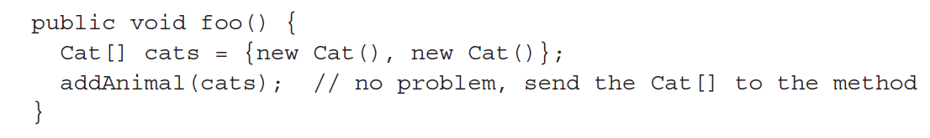
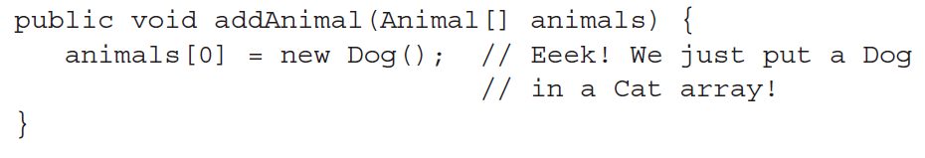
What can be done and what can not ?
ArrayStoreException

Slide 23
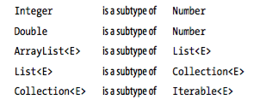
Subtyping and the Substitution Principle
Subtyping is a key feature of object-oriented languages such as Java.
In Java, one type is a subtype of another if they are related by an extends or implements clause.
Subtyping is transitive, meaning that if one type is a subtype of a second, the second is a subtype of third, then the first is a subtype of the third
Examples:
Conversely, Number is a supertype of Integer etc.

Slide 24
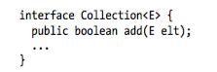
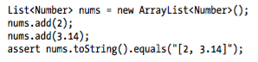
Substitution Principle
a variable of a given type may be assigned a value of any subtype of that type, and a method with a parameter of a given type may be invoked with an argument of any subtype of that type.
Example:
ArrayList<Number> is a subtype of List<Number>
Integer and Double are subtypes of Number

Slide 25
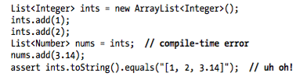
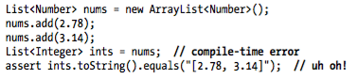
Substitution Principle, cont.
However, notice the following:
List<Integer> is NOT a subtype of List<Number>
What about the reverse?
Nor the other way around

Slide 26
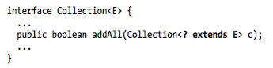
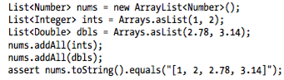
Wildcards with extends
Most likely, till now you have encountered such a method definition:
The phrase in bold (“? extends E”) means you could add all members of a collection with elements of any type that is a subtype of E
Example:

Slide 27
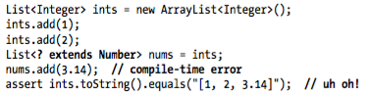
Declaring variables with wildcard
We can also use wildcards when declaring variables, however:
List<? extends Number> can be a List of ANY subtype of Number
List<? extends Number> is, in fact, List<Integer>
So what can we do about it?
super to the rescue!
Notes:
Deklarowanie, nie inicjalizacja!

Slide 28
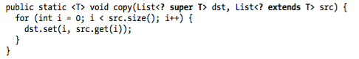
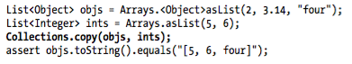
Wildcards with super
Consider this method from Collections class:
The phrase “? super T” means that the destination list may contain elements of any type that is a supertype of T
Sample call:

Slide 29
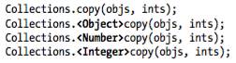
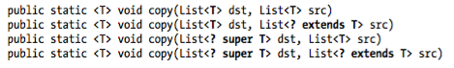
Wildcards with super, cont.
Calling the method with explicit type parameters:
What would happen if we changed the method declaration?
Notes:
To jest grubszy temat, jeśli starczy czasu to dokoncze
Too restrictive (copying only Integers to Integers)
Works only with Collections.<Object>copy(objs, ints);
Works only with Collections.<Integer>copy(objs, ints);
Works with all calls (implicit and explicit)

Slide 30
The Get and Put Principle

Slide 31
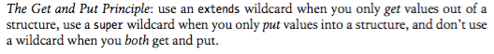
The Get and Put Principle
It is a good practice to use wildcards whenever possible, as it makes your API flexible
However, how do we know where to use super and where to use extends?
Notes:
Important stuff!

Slide 32
The Get and Put Principle, cont.
Recall the previous example:
We declare List<? extends T> src since we only get the values from src List
We declare List<? super T> dst since we only put values into dst List
Notes:
Important stuff!

Slide 33
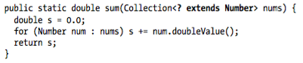
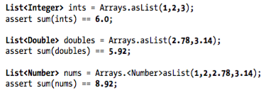
The Get and Put Principle, cont.
Whenever you use an iterator, you get values out of a structure, so use extends:
As it uses extends, all the following calls are legal:
Notes:
Important stuff!

Slide 34
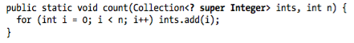
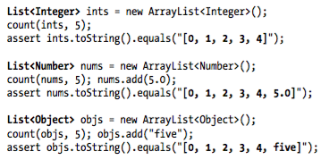
The Get and Put Principle, cont.
Whenever you use the add method, you put values into the structure, so use super
As it uses super, all the following calls are legal:
Notes:
Important stuff!

Slide 35
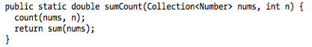
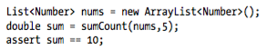
The Get and Put Principle, cont.
Whenever you both put values into and get values out of the same structure, do not use a wildcard
Since there is no wildcard, the argument must be a collection of Number:
Notes:
Important stuff!

Slide 36
The Get and Put Principle, cont.
You may wonder if you can write a wildcard with both extends and super..
You cannot, but this actually may change in the future
Notes:
Important stuff!

Slide 37

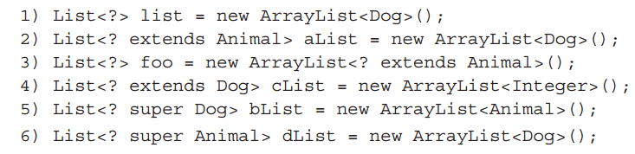
Get and put aka PECS

Slide 38
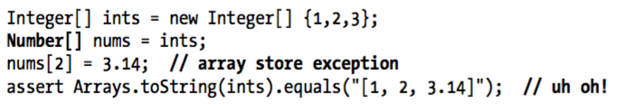
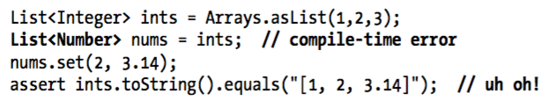
Covariant vs Invariant Subtyping
In Java, array subtyping is covariant, meaning that type S[] is considered to be a subtype of T[] whenever S is a subtype of T.
Generic subtyping, on the other hand, is invariant, which means that List<S> is not considered a subtype of List<T> (except if S and T are identical)
Exception thrown in run time!
Exception thrown in compile time!
Wildcards reintroduce covariant subtyping for generics
Notes:
Important stuff!

Slide 39
Wildcard Capture
TODO
Notes:
Important stuff!

Slide 40
Restrictions on Wildcards

Slide 41
Restrictions on Wildcards
Although very useful, there are some restrictions when using wildcards. Wildcards may not appear:
At the top level in class instance creation expression (new)
In explicit type parameters in generic method calls
In supertypes (extends and implements)

Slide 42
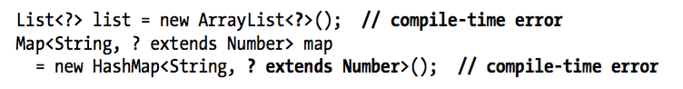
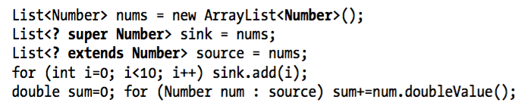
Instance Creation
In a class instance expression, if the type is a parameterized type, then none of the type parameters may be wildcards
It is, however, legal to use wildcard when declaring variables
Notes:
Important stuff!

Slide 43
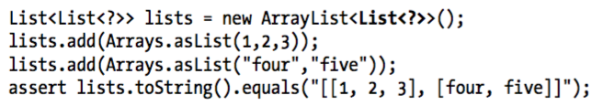
Instance Creation, cont.
Also, only the top-level parameters in instance creation are prohibited
Nested wildcards are permitted:
The reason for that is even though the list of lists is created at a wildcard type, each individual list has a specific type (integers and strings, respectively)
Wildcard – ordinary type relationship is similar to interface – class relationship
Notes:
Important stuff!

Slide 44
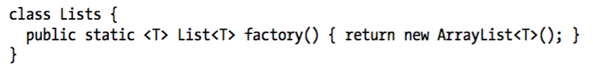
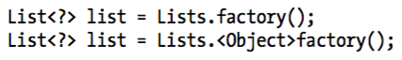
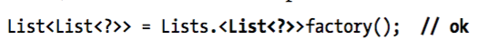
Generic Method Calls
If a generic method call includes explicit type parameters, those parameters must not be wildcards
Consider the following method:
It can be called either using implicit or explicit type parameter:
However, using a wildcard as an explicit type parameter is not allowed
Nested parameters are allowed though (see previous slides)

Slide 45
Supertypes
When a class instance is created, it invokes the initializer for its supertype
Hence, any restriction that applies to instance creation must also apply to supertypes
When declaring a class, which supertype (or superinterface) has type parameters, these type cannot be wildcards:
Again, wildcards in nested type parameters are legal

Slide 46
Bounds

Slide 47
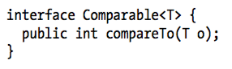

Comparable
Interface Comparable<T> contains a method that can be used to compare one object to another:
The compareTo method returns a value that is negative, zero and or positive depending on whether the argument is less than, equal to or greather than the given object
For example, Integer implements Comparable<Integer>:

Slide 48


Comparable, cont.
The type parameter allows to catch nonsensical comparisons at compile time:
Obviously, you cannot use compareTo with types that does not implement Comparable (like Number)

Slide 49

Maximum of a Collection
Using Comparable, we can easily find a maximum of a Collection. Consider the following method that returns the greatest element of the collection:
It’s a generic method that introduces a bound on the type variable
Basically, this method takes a collection of type T and returns a T, and it does so for any type T such that T is a subtype of Comparable<T>

Slide 50


Maximum of a Collection, cont.
When calling the method, T may be chosen to be Integer (since Integer implements Comparable<Integer>):
Or T may be chosen to be String (since String implements Comparable<String>):
But, as expected, T may not be chosen to be Number (as Number does not implement Comparable<Number>)

Slide 51

Maximum of a Collection, cont.
Let’s recall “Get and Put Principle”?
Use wildcards whenever possible!
How can we make this method more flexible?
Use extends with Collection, as we only read from it, and use super with Comparable<T> as we put values into compareTo method:
If you look at the Java library, you will see that it is even more complicated:
This is to maintain backwards compatibility with Java 1.4 and earlier

Slide 52


Fruity Example
Let’s consider the following example:
This let’s us not only compare same fruits (like apples with apples), but also compare distinct fruits (like apples with oranges)

Slide 53


Fruity Example 2
Now, let’s consider the following one
This time, we’re only allowed to compare same kinds of fruits
Would this work if we kept the original max method declaration?

Slide 54

Fruity Example 2, cont.
The original method signature
Let’s take T to be Orange:
But, Orange does not implement Comparabie<Orange>!
It implements Comparable<Fruit>
Orange extends Comparable<Orange>

Slide 55
Fruity Example 2, cont.
Let’s see the wildcard-tuned method declaration:
Again, we take T to be Orange:
And this is true because both of the following hold:
Orange extends Comparable<? Super Orange>
Orange extends Comparable<Fruit> and Fruit super Orange

Slide 56

Multiple Bounds
Sometimes, it is desirable to bound a method with more than one class or interface
Multiple bounds are often used for maintaining backwards compatibility:
Notice that src uses methods from both Readable and Closeable interfaces!

Slide 57

Generic classes in the nutshell

Slide 58


Constructor
Look out for this – no compile-error, but will generate unchecked warning

Slide 59



Static members
Compile-time error
Compile-time error

Slide 60


Nested classes
Nested public or private class

Slide 61


Nested classes
Nested static public or private class

Slide 62


Generic Methods
Non generic class with static and non static method
Generic class with static and non static method

Slide 63

Generic Methods with varargs
Non generic class with generic static method

Slide 64


Generic Exceptions
Compile-time error
This is not allowed
Reason: not-reifiable type in catch clausle should be used to catch such exception
Generics are allowed in throws clausule.

Slide 65


How to get instance of the generic type T?
Compile-time error
This is not allowed
Reason: type erasure – T is not reifiable type and will be Object in this case
This is workaround for the issue

Slide 66



How to get instance of the array of the generic type T?
Compile-time error
This is not allowed
Reason: type erasure – T is not reifiable type and will be Object in this case
This is workaround for the issue

Slide 67

Thanks for attention!

Slide 68
Agenda Item 1

Slide 69
Agenda Item 1

